Slide 1

Basic Details of the Team and Problem Statement
Ministry/Organization Name/Student Innovation: Ministry of Education
PS Code: 1433
Problem Statement Title: Mental health and well-being surveillance, assessment and tracking solution among children.
Team ID: 16 Team Name: TechnoGeeks
Team Leader Name: Nisarg Patel
Institute Code (AISHE): U-0147
Institute Name: Pandit Deendayal Energy University, Gandhinagar
Theme Name: Smart Education

Slide 2
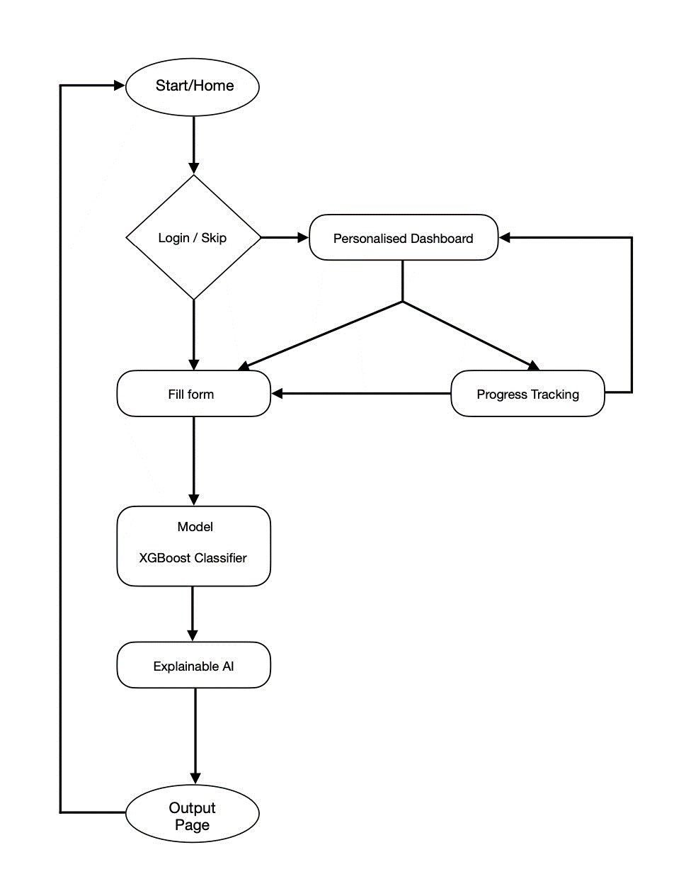
Idea/Approach Details
Describe your Technology stack here:
HTML, CSS, Bootstrap
Python, Flask
Libraries:
Numpy
Pandas
Matplotlib
Scikit-learn
Joblib
Describe your idea/Solution/Prototype here:
Our main idea is to assist children assess and track their mental health.
We have provided a solution that revolves around leveraging data-driven techniques and machine learning to address mental health surveillance, assessment, and tracking among children
We collected data via an online survey, of different children regarding their mental health.
We built a ML model (with an accuracy of 75%) to ask children to fill a form and predict their mental health.
We also offer personalized recommendations to children based on the survey responses they provide. These recommendations are tailored to the individual, suggesting specific factors they can work on to reduce stress or anxiety levels.

Slide 3
Idea/Approach Details
Describe your Use Cases here
Describe your Dependencies / Show stopper here
Our project has several important use cases that can benefit children, parents, educators, and mental health professionals.
It provides early detection that allows for timely intervention and support, potentially preventing the escalation of mental health problems.
Parents can gain insights into their child's emotional state and receive guidance on fostering a healthy home environment.
It empowers children to take charge of their mental well-being and learn strategies to manage stress or anxiety.
It enhances the effectiveness of remote therapy by providing additional data points and insights for therapists.
There are various potential dependencies or showstopper that should be considered.
Ensuring compliance with data privacy regulations (e.g., GDPR, HIPAA) and securing sensitive information is critical.
The accuracy and representativeness of the dataset is crucial for reliable predictions.
Collaborating with mental health professionals or experts is essential for creating accurate assessments and recommendations
Ethical guidelines and practices must be integrated into the project to ensure responsible AI and data usage.
Users (children, parents, educators) need to engage with and adopt your platform.
Future Scope:
Enhanced Data Collection
Explainable AI
Improving personalized recommendation and user feedback
Parental Access

Slide 4
Team Member Details
Team Leader Name: Nisarg Jignesh Patel
Branch (Btech/Mtech/PhD etc): Btech Stream (ECE, CSE etc): CSE Year (I,II,III,IV): III
Team Member 1 Name: Chahat Vasant Khatri
Branch (Btech/Mtech/PhD etc): Btech Stream (ECE, CSE etc): ECE Year (I,II,III,IV): III
Team Member 2 Name: Padshala Smit Jagdishbhai
Branch (Btech/Mtech/PhD etc): Btech Stream (ECE, CSE etc): CSE Year (I,II,III,IV): III
Team Member 3 Name: Tej Joshi
Branch (Btech/Mtech/PhD etc): Btech Stream (ECE, CSE etc): CSE Year (I,II,III,IV): III
Team Member 4 Name: Tapan Patel
Branch (Btech/Mtech/PhD etc): Btech Stream (ECE, CSE etc): CSE Year (I,II,III,IV): III
Team Member 5 Name: Shlok Bijal Sanghvi
Branch (Btech/Mtech/PhD etc): Btech Stream (ECE, CSE etc): CSE Year (I,II,III,IV): III

